Slide 1

Business Analytics Capstone Framework for Strategy
Anggi Firdian Saputra
30 August 2022

Slide 2
Problem Statement

Slide 3
Problem Statement– Describe the Problem Adblockers present to GYF
Use this space for describing the problem. Be as specific as possible! You should focus on the implications of adblockers on GYF’s ad-buying customers; in exploring this, you might also consider the implications for GYF’s end users, operations, and/or internal organization.
A major portion of GYF’s revenue comes from selling advertising to other companies who place ads on GYF’s digital services.
AdBlock is an open source content filtering and ad blocking extension for the Google Chrome and Apple Safari web browsers. AdBlock allows users to prevent certain web elements such as ads from appearing.
If GYF is unable to display ads to the customers, the companies posting the ads will have no reason to put the ads. Thus resulting in termination by the companies and loss of revenue to GYF.
1. How many end-users from our base are vanished due to ad-blockers and what segment of users are they?
Decreasing end-users would make incomplete data analytics and business analysis. So, we could not capture perfectly the end-users background, preferences, and behavior from whole end-users population as this is crucial to prospected B2B/B2C to reach their invaluable customers.
2. Why do users use ad-blockers?
The basic reason from the user is very necessary because with these basic reasons we can find out why users use adblockers. Is it because of irrelevant ads from their preferences?, is too many ads are obtained on one page?, is the design confusing?, is the image, video, and photo size not proportional?, or the page deliverable is so slow?.
3. What kind of behavior are our users before they are starting to use ad-blockers? How was our ads appearance before they are waving goodbye to our service?
This is to identify Recency, Frequency, and Monetary (RFM) to know their CLV and behavior before they start to use ad-blockers.
4. How large the monetary aftermath would be affected due to ad-blockers?
Declining end-users would also degrade our CTR possibility that would have a bad impact to conversion and revenue subsequently
5. What measures could be taken to change or strengthen GYF’s internal organization to deal with adblockers?
This is done to find a solution regarding adblockers so that we can compete with other companies, the best solution that will be obtained can increase GYF’s revenue.

Slide 4
Problem Statement– Application Exercise 1 – Research Methods and Tools (Optional)
Use this space for to answer the questions set out in Application Exercise 1: 1. Given your definition of the problem faced by GYF, what type(s) of research will you employ to learn more about the strategy the DATA Team should pursue? 2. What research tools could you use to conduct that research?
The research we will be using is Descriptive Research.
Now, we are aware of the issue of ad-blockers on GYF, where we need to reveal the implication of the issue by unleashing the numbers of how big it would impact our users base and our financial bottom line and we need to identify the root of causal problem or reason of end-users use ad-blockers.
As the next step, we will be using Causal Research, especially A/B Testing to conduct new native ads appearance to make end-users more comfortable, which ones would be a preference to the end-users to take up the conversion rate. By then we could subsequently decide what strategy we need to conduct to anticipate and mitigate if the result goes rough.
Research Tools To Conduct That Research is From:
Scanner Data. In the back-end which could track whether end-users are using ad-blockers or not. If using ad-blockers, we need to record their time stamp by using JavaScript to investigate their behavior prior to using ad-blockers. With this data, we can do modelling through ML of which from our users base are alleged to churn by using ad-blockers.
Mobile Survey. To investigate the main drivers of end-users who use ad-blockers as the causal problem.
Mobile Data Analytics. To know whether a segment of our end-users is using ad-blockers, and how far it would impact our end-users data analytics.
Social Media. To capture our ads engagement and ads personal.
Pricing Analysis. To decide which option would be suitable: charging the customers or paying the adblocking companies to get whitelisted.

Slide 5
Strategy

Slide 6
Strategy Describe your proposed strategy
Make sure your strategy is clear, well-defined, and feasible
A single strategy is not sufficient to tackle this problem. So a multiple strategy approach is recommended. The strategy of ad-blockers threat is basically lies in creating a sustainable advertisement ecosystem, where there are two strategies:
Generating a much greater advertising experience for users to see the ads without pushing them, with the following points:
Tighten Quality of Assurance (QA) of advertisement content, where the ad’s content deliverable should be a gift, delightful, informative, meaningful, useful, invisible, inspirational, and indispensable part of product and service experiences, taking into the improvement of page load time so that it does not take a long time when load the page. The company will build one dedicated team to handle the content of the creative ads for B2B/B2C customers of GYF ads who can consult the content value.
Executing A/B Testing on different ads experiences to each segment of user bases. To know the end-users preference, and deploy the result which new native ads appearance suit best for each segment.
Create GYF built-in ad-blocking to make end-users choose their own preference to prohibit the access of ads or not. If they are choosing to activate the GYF built-in ad-blocking, GYF analytics still can fetch the end-users cookies, links clicked, and other data to do further analytics. For end-users who already used 3rd party ad-blockers, we are sending the prompt that asks whether they will turn off the old one and activate GYF built-in ad-blocking considering their data security is crucial to unknown 3rd parties.
The Ambidextrous Tactics to boost the strategy itself, with the following points:
Create a solid culture of ads team members. By building an execution culture that lays out key decision, action, support the model and execution plan with effective incentives and controls, which take agreement and commitment are sought and rewarded consideration. This culture would lead to successful strategy execution and avoid members turnover challenges.
Create a collaborative ecosystem all across search engine companies and publishers by holding a consortium to ‘drive’ the industry that potentially becomes an industry barrier, as for the case to standardize the ads content to not be so invasive and too bloated.
If these trials fail to provide a desirable result, an analysis must be conducted on the most feasible solutions out of the following 3 options: Charging the customers vs Paying to get whitelisted vs Paying anti adblocking companies. In the end we must choose the most economic option of the three.
Although it would not be a good idea to pay the adblockers to get whitelisted since there is a chance of some other adblocker that might block our content. This should be adopted only as a short-term solution.

Slide 7
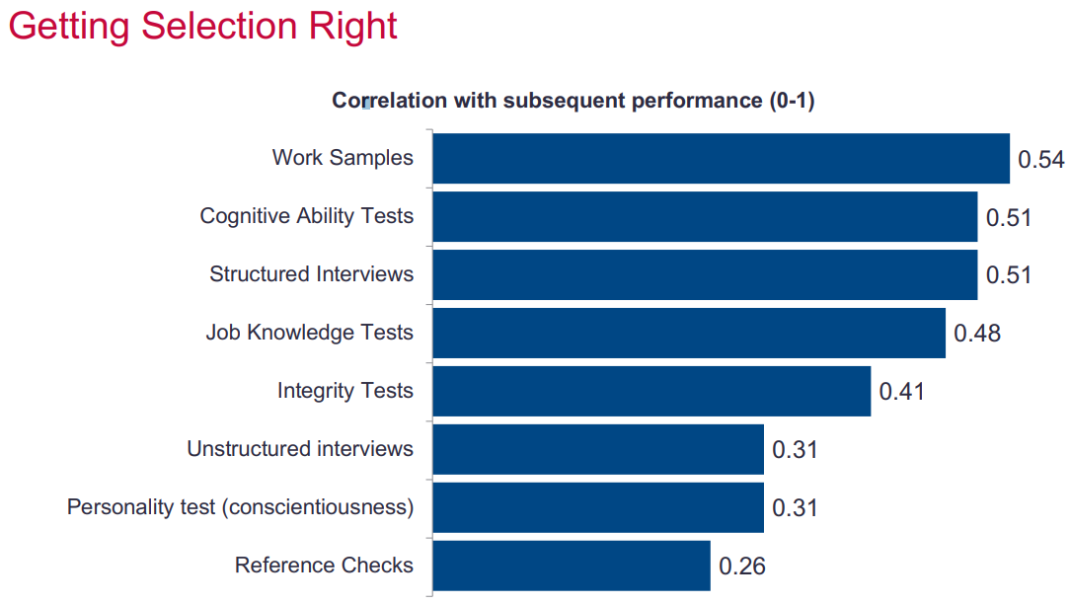
Strategy Application Exercise 2 – Hiring a Team Leader (Optional)
Based on the information provided in Application Exercise 2, describe here why you would hire Carrie Candidate or Peggy Prospect to be the second-in-command of the DATA Team.
As the leader of the DATA Team at GYF, I am looking for a new Senior Associate Director for Digital Advertising Strategy. This person will be my second-in-command as I develop and implement my strategy for addressing the problem of adblocking.
I would hire Peggy Prospect as a new Senior Associate Director for
Digital Advertising Strategy, because apart from having excellent
academic scores, she also has prior experience in the relevant field
and that experience might come in handy to save time and money in
our strategy application.
Although she scores based on metric assessment results a bit low on
the cognitive test than Carrie Candidate, the other test parameters
show promising prospects. She already has knowledge of what kind of
work is expected from her. This might save the valuable time and money
that would have been lost in training her to get acclimated to her role.
References are not a great indicator of employee performance. Hence it is
advisable to ignore it since both the candidates scored nearly similar on the
reference scale.
Peggy excels in working in a team, this is really needed to make a strategy because Peggy can communicate well and can produce a better solution. This is very necessary because making and executing a strategy requires many factors from all elements both within the company and outside the company.
Picture Metric Assessment
Bidwell, Matthew. Staffing Analytics Slide. Wharton, University of Pennsylvania.

Slide 8

Effects and Measurement

Slide 9
Effects Describe the anticipated effects of your strategy
Please describe the anticipated effects of your strategy. Make sure you address the effects on customers, revenue, and the internal organization.
The following are the anticipated effects of the strategy of creating a sustainable advertisement ecosystem:
The first proposed strategy is to generate a much greater advertising experience (by tightening QA of advertising content’s deliverable, deploying the result in which new native ads appear as a result of A/B testing) would be addressed end-users loyalty by staying on our page without taking any action to install ad-blocking software. End-users would pleasantly stay on the page because they are perceiving valuable and informative insight from the ad’s content. Subsequently, brand awareness and customer engagement can be reached.
For such circumstances we are maintaining our user base, which becomes key players to the ads impression, click, conversion
(if any of them are piqued by the product/service), and subsequently would bring beneficiary impact to profit our customer
and our revenue. Internally, as mentioned I dedicated team of creative content advertisement is needed to ensure the quality,
this might need the accrual cost and hind the financial statement, but it would make a significant impact on long-term
corporate value.
The second strategy is ambidextrous tactics by creating a solid innovative and collaborative culture in the advertising team would also make successful strategy execution and a great way to avoid member turnover challenges. As of trade-off, the considerable incentive for those who perform well is encountered, but it will make a conducive ecosystem to achieve considerable growth which improves the intangible asset and competitiveness factor of the company and become an indirect driver of long-term growth.
If we start charging the customers, we might expect a decrease in the number of users who use our services thus decreasing revenues.
From Financial Standpoint, charging the customers might increase or decrease the revenue depending on the number of users who quit.
If customer satisfaction increases, the publishers might be willing to invest more in advertising on our platforms.

Slide 10
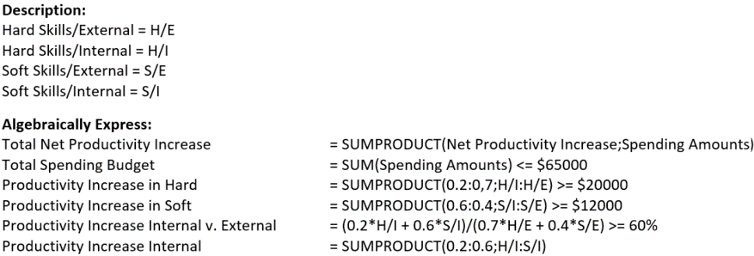
Effects Application Exercise 3 – Designing a Deterministic Optimization Model
Provide an explanation of the calculations you performed to build an optimization model using decision variables, constraints, and an objective; this model could use the scenario in Application Exercise 3, or one of you own devising.
Optimization Model on Training Program Use the Scenario in Application Exercise 3.
To get the best decision, I use a tool of solver in Microsoft Excel.
From the analytic of solver that is shown in the appendix page section, in order to maximize the productivity return which obtained $42.823 after doing the calculation of solver, the spending amount of training on Hard Skill/Internal and Soft/Skill External are 0, that means does not need to conduct any training both. The company should consider the budget expense of $26.765 for training on Soft Skill/Internal and $38.235 for training on Hard Skill/External.
However, according to me, there are several considerations such as any modeling has a limitation that could not scope the correlation between predicted and objective entirely, and training programs are related to human resources of which we know that people are the product of dynamic change and growth, thus training on Hard Skill/Internal and Soft Skill/External might also imperative for employees to do the job greatly. This is the case when blending the experts and analytics are considerably needed to achieve a much greater outcome toward the company’s objective.

Slide 11
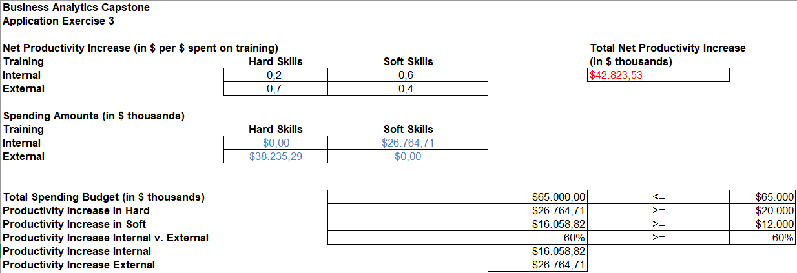
Effects - Appendix Application Exercise 3 – Designing a Deterministic Optimization Model
Provide an explanation of the calculations you performed to build an optimization model using decision variables, constraints, and an objective; this model could use the scenario in Application Exercise 3, or one of you own devising.

Slide 12
Measurement Describe the anticipated effects of your strategy and how you will measure them
Please outline your plan for measuring these effects using data. Make sure you use techniques you learned about in the courses.
The anticipated effects can be measured in the following ways:
Measurement of Ads Performance
Ads experience can be measured by the number of impressions, and video play length 25%, 50%, 76%, or 100% (quantiles)
Ads performance can be measured by:
Return of Investment (ROI) metrics (Revenue – Cost of goods sold) / Cost of goods sold
Brand awareness which can be seen from the number of impressions
Customer engagement can encounter by Click-Through Rate (CTR) and conversion rate
Customer satisfaction can be assessed from the surveys conducted.
Measurement of Internal Performance
Innovative culture: percent growth of innovation produced
Collaborative culture: percent drop of employee turnover and evaluation result of Collaborative Network
Growth in Intangible Assets.
Measurement of Company Competitive Advantage Across Industry
Return on Equity
Profitability which measures Return on Assets and Return on Sales
Efficiency encountered Assets Turnover as the key ratio
Balanced scorecard
The revenues can be measured in traditional ways.
The added factors of subscription charges can also be used in revenue measurements.

Slide 13
Measurement Application Exercise 4 – Identifying Key Drivers
Apply the “causal business model” performance measurement framework to your strategy
Causal Business Model Performance Measurement Framework
The purpose of making this causal business model is to achieve net income growth from advertisement services against ad-blocking.
Measurement:
Great experience from ads content can be seen from Brand Awareness measured by the number of impressions, Customer Engagement measured by CTR, ROI metrics, and subsequently to results of a survey conducted.
Causal Business Model as Hypothesis:
When users perceive a greater experience of ads content, this is would increase end-users loyalty where they would not install ad-blocking which would impact the number of impressions, CTR, and Conversion with driver revenue of GYF’s clients. Where more profit per impression achieves, leads to more GYF’s revenue in the long run.
Hypothesis validation:
To Conduct research and modeling through multivariate regression analysis to know whether the experience of ads contents taking the most valuable predictor to revenue increase among other key drivers, i.e. solid innovation and collaborative culture of ads team members. If it does, then the payment value of predictor experience of ads content would be the highest.
Supporting data needed:
Scanner Data. To know the growth of impressions, clicks, conversion, and turnover of ad-blockers users.
Mobile Survey from end-users population regarding ads performance measurement.
Mobile Data Analytics. To know whether a segment of our end-users is using ad-blockers, and how far it would impact our end-users data analytics.
Social Media. To capture our ads engagement and ads personal.
Number of innovations produced and perform
Evaluation results of the collaboration network
Financial measurement metrics.
Pricing Analysis. To decide which option would be suitable: charging the customers or paying the adblocking companies to get whitelisted.
Optional other key drivers for revenue increase or decrease:
Decrease in Obtrusive ads: This will increase customer satisfaction which will lead to not using adblockers which will help to retain more publishers which will lead to the prevention of losses.
Charging the customers: This will lead to a decrease in the number of users but might lead to an increase or decrease in the revenue depending on customer turnover.
Paying the adblocking companies: This might lead to short-term revenue but might help in the long term by retaining publishers and decreasing losses.

Slide 14
Measurement Application Exercise 4 – Identifying Key Drivers
Apply the “causal business model” performance measurement framework to your strategy
Linking non-financial metrics to financial objective
There is also a probability when the key driver mentioned would not perform. If this happened, we should find out why. There are three possible reasons that are the strategy aligned wrong, the measurement is garbage where we can eliminate this possibility since we use common measurement in the industry for a decade, and the people who are doing the job are not dependable.
This is when financial metrics take a considerable role in financial objectives. We should evaluate and do the right measurement on non-financial metrics (in this case the innovative and collaborative culture, management capability, employee relation, quality, and brand value) to know the causal reason of the issues. If the case is solved, which we see the highest predictable factor of key drivers makes increasing net income successfully, this means both non-financial metrics and financial outcomes are highly correlated as it supposed to be. That is why most of the corporations nowadays use a Balanced Score Card to measure how well one company is doing, especially their competitive advantage across the industry.

Slide 15
Conclusion
Summarize your key points from the preceding slides.
The ad-blockers become a threat for the company as advertisement takes 70% of the revenue stream of the company. The first thing we need to do further descriptive research to reveal the implication of the issue by unleashing the numbers of how big it would impact our users base and our financial bottom line and we need to identify the root of the causal problem or reason of end-users use ad-blockers. With the supporting data needed such as scanner data, mobile survey, mobile data analytics, social media, and pricing analysis.
There are two strategies to against ad-blockers that is generating a much greater advertising experience where there are three main aspects as follows tighten QA, execute A/B Testing on different ads experiences, create GYF built-in ad-blocking, and the other strategy is the ambidextrous tactics with the following points are create a solid culture of ads team members, and create a collaborative ecosystem.
The following are the anticipated effects of the strategy of creating a sustainable advertisement ecosystem the first proposed strategy is to generate a much greater advertising experience (by tightening QA of advertising content’s deliverable, deploying the result in which new native ads appear as a result of A/B testing) would be addressed end-users loyalty by staying on our page without taking any action to install ad-blocking software. The second strategy is ambidextrous tactics by creating a solid innovative and collaborative culture in the advertising team would also make successful strategy execution and a great way to avoid member turnover challenges.
The anticipated effects can be measured in the following ways the first measurement of ads performance in a way ads experience can be measured by the number of impressions, and ads performance can be measured by ROI, Brand Awareness, CTR, and Survey. The second measurement of internal performance in a way innovative culture, collaborative culture, and growth in intangible assets. The third, measurement of company competitive advantage across industry in a way ROE, ROA, ROS, efficiency encountered assets turnover as the key ratio, and balanced scorecard. The revenues can be measured in traditional ways.
As the final step we need to linking the non-financial strategies to financial outcomes by conducting research and modeling through Multivariate Regression Analysis to know whether the experience of ads contents taking the most valuable predictor for revenue increase.
Once we have solved the real reason behind (might change the causal business model). We will see the highest predictable factor of key drivers makes increasing net income successfully, this means both non-financial metrics and financial outcomes are highly correlated as it supposed to be. This means non-financial takes an important role in financial outcomes.

